Slide 1


Advanced Computer Architecture Fall 2020
Hamed Farbeh
farbeh@aut.ac.ir
Department of Computer Engineering
Amirkabir University of Technology
Lecture 5

Slide 2
Copyright Notice
Lectures adopted from
Computer Architecture: A Quantitative Approach, 5th edition, John L. Hennessy,‎ David A. Patterson, MK pub., 2019
Advanced Computer Architecture-Fall 2020, AUT, Tehran, Iran

Slide 3
Computer Architecture
A Quantitative Approach, Sixth Edition
Chapter 3
Instruction-Level Parallelism and Its Exploitation

Slide 4
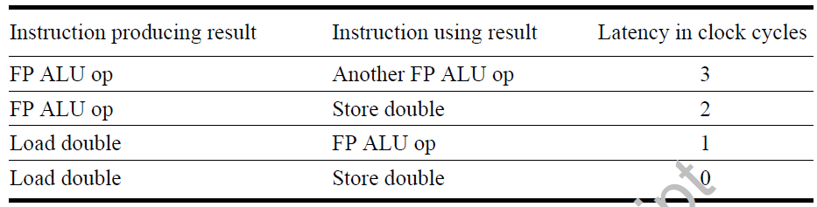
Compiler Techniques for Exposing ILP
Compiler Techniques
Pipeline scheduling
Separate dependent instruction from the source instruction by the pipeline latency of the source instruction
Example:
for (i=999; i>=0; i=i-1)
x[i] = x[i] + s;

Slide 5
Pipeline Stalls
for (i=999; i>=0; i=i-1)
x[i] = x[i] + s;
Loop: fld f0,0(x1)
stall
fadd.d f4,f0,f2
stall
stall
fsd f4,0(x1)
addi x1,x1,-8
bne x1,x2,Loop
Compiler Techniques
Loop: fld f0,0(x1)
addi x1,x1,-8
fadd.d f4,f0,f2
stall
stall
fsd f4,8(x1) bne x1,x2,Loop

Slide 6
Loop Unrolling
Compiler Techniques
Loop unrolling
Unroll by a factor of 4 (assume # elements is divisible by 4)
Eliminate unnecessary instructions
Loop: fld f0,0(x1)
fadd.d f4,f0,f2
fsd f4,0(x1) //drop addi & bne
fld f6,-8(x1)
fadd.d f8,f6,f2
fsd f8,-8(x1) //drop addi & bne
fld f0,-16(x1)
fadd.d f12,f0,f2
fsd f12,-16(x1) //drop addi & bne
fld f14,-24(x1)
fadd.d f16,f14,f2
fsd f16,-24(x1)
addi x1,x1,-32
bne x1,x2,Loop
note: number of live registers vs. original loop

Slide 7
Loop Unrolling/Pipeline Scheduling
Compiler Techniques
Pipeline schedule the unrolled loop:
Loop: fld f0,0(x1)
fld f6,-8(x1)
fld f8,-16(x1)
fld f14,-24(x1)
fadd.d f4,f0,f2
fadd.d f8,f6,f2
fadd.d f12,f0,f2
fadd.d f16,f14,f2
fsd f4,0(x1)
fsd f8,-8(x1)
fsd f12,-16(x1)
fsd f16,-24(x1)
addi x1,x1,-32
bne x1,x2,Loop
14 cycles
3.5 cycles per element

Slide 8
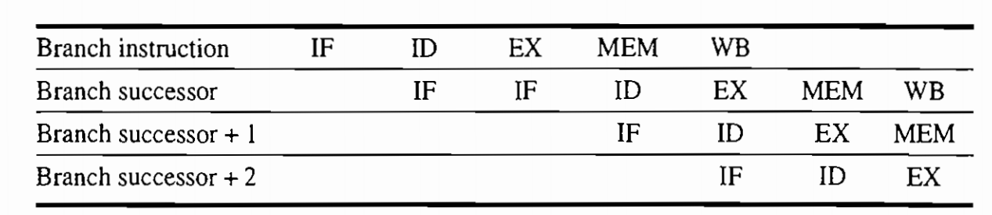
Branch Hazards ^{(appen. C)}
Branch Prediction
One stall cycle for every branch
10% to 30% performance loss
Reducing pipeline branch penalties

Slide 9
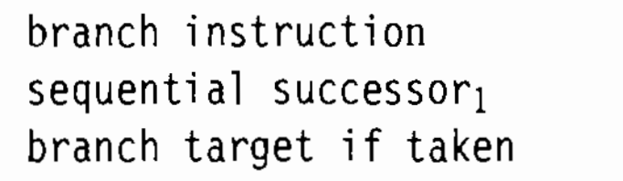
Reducing branch penalties
Branch Prediction
Predicted-not-taken
Continuing to fetch instructions
Restart the fetch at the target address if taken
Predicted-taken
Fetch the target address as soon as possible
Backward taken and forward no-taken
Delayed branch

Slide 10
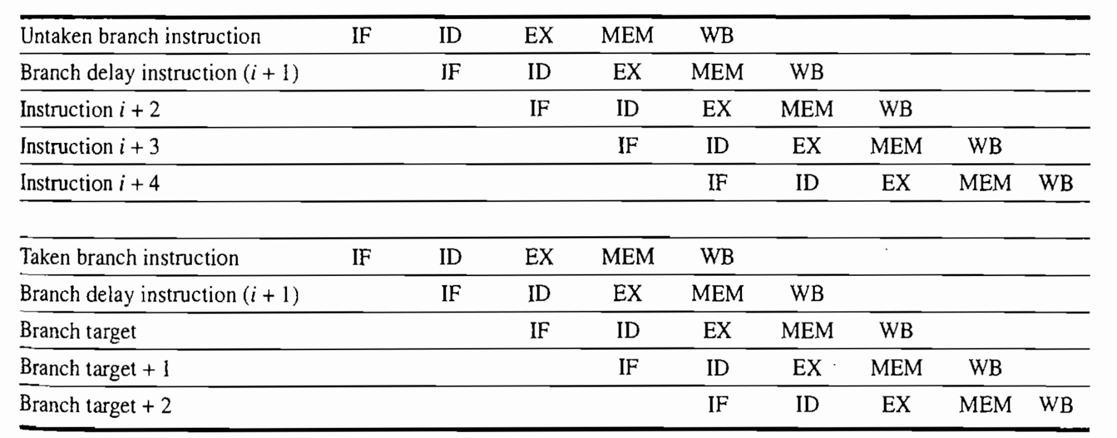
Delayed branch
Branch Prediction

